Slide 1
RECURSIVE TRANSFORMER BASED SEMANTIC
VIDEO SEGMENTATION
MASTER THESIS RESULTS
Aysha Athar Siddiqui
Rheinische Friedrich-Wilhelms-Universität Bonn
Computer Science Institute VI: Autonomous Intelligent Systems

Slide 2


Problem definition
Given a sequence of frames x₁, x₂, x₃, …x_{N} extracted from a video sequence.
Predict the segmentation maps s₁, s₂, s₃, ....s_{N} for each frame in the video sequence.
Original Video
Segmentation model
Segmented Video

Slide 3
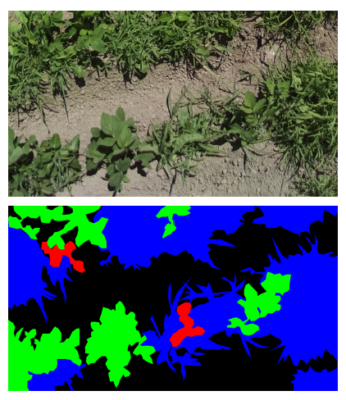
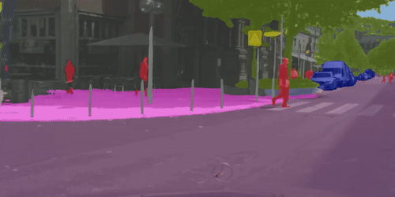
Applications
Self driving cars
Agriculture
Autonomous navigation for robotic wheelchairs
Robotics
Visual effect assistance and much more
Notes:
To-do: make this better, add some more visual images

Slide 4
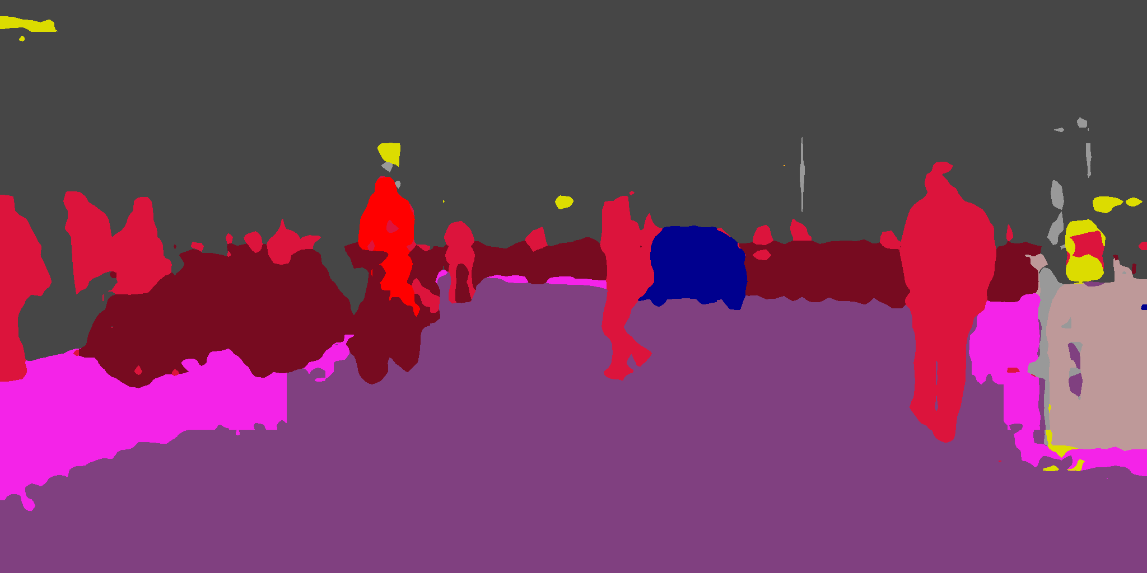

Motivation
Image segmentation - Extended to video data - Frame by frame segmentation
Leads to noisy, flickered segmentations.
Does not take into account temporal relations.
Essential to model temporal coherence between video frames.

Slide 5
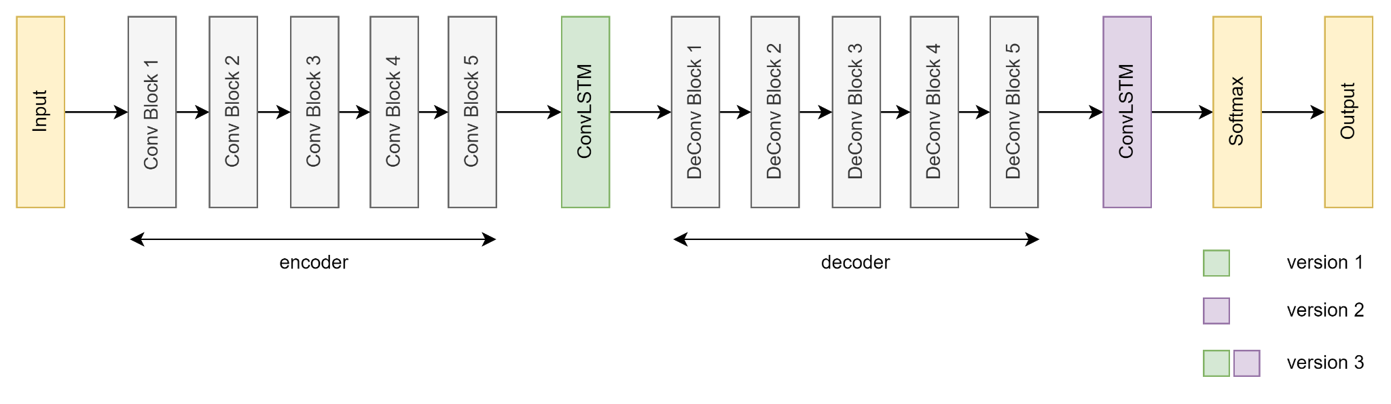
Related Work - LSTM SegNet
Extension of SegNet by adding RNNs (ConvLSTM)
Three positions
Between encoder and decoder
After the decoder
Both combined
Weak performance compared to SOTA methods
Pfeuffer, Andreas, et al. "Semantic segmentation of video sequences with convolutional lstms." IV 2019.

Slide 6
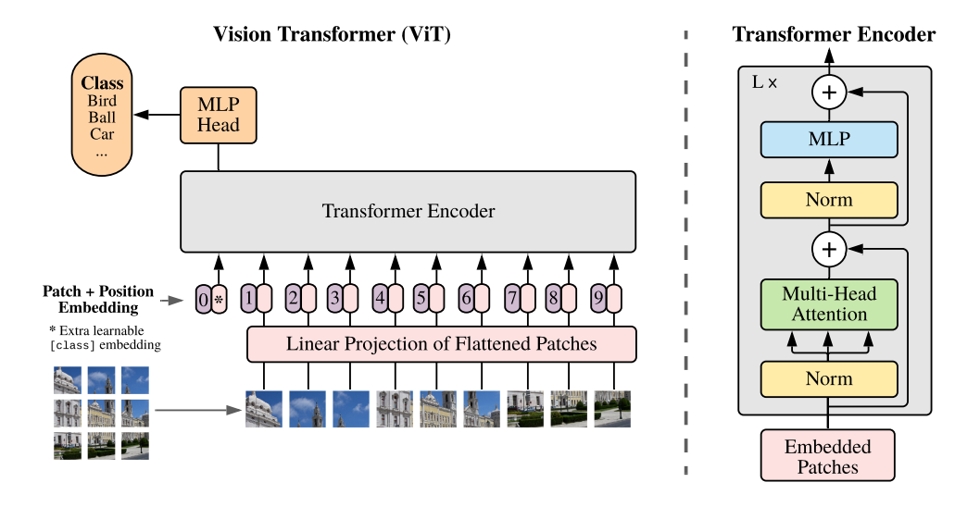
Related Work - Vision Transformer
Dosovitskiy, Alexey, et al. "An image is worth 16x16 words: Transformers for image recognition at scale." ICLR 2021.

Slide 7
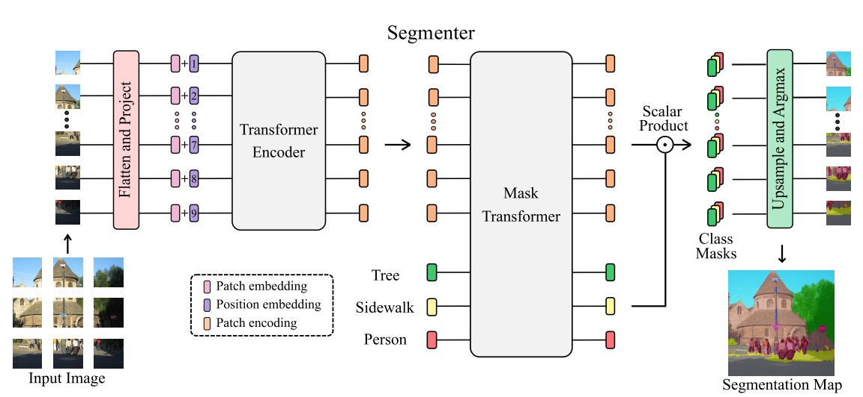
Related Work - Segmenter
Strudel, Robin, et al. "Segmenter: Transformer for semantic segmentation." CVPR. 2021.

Slide 8
VideoSegmenter

Slide 9
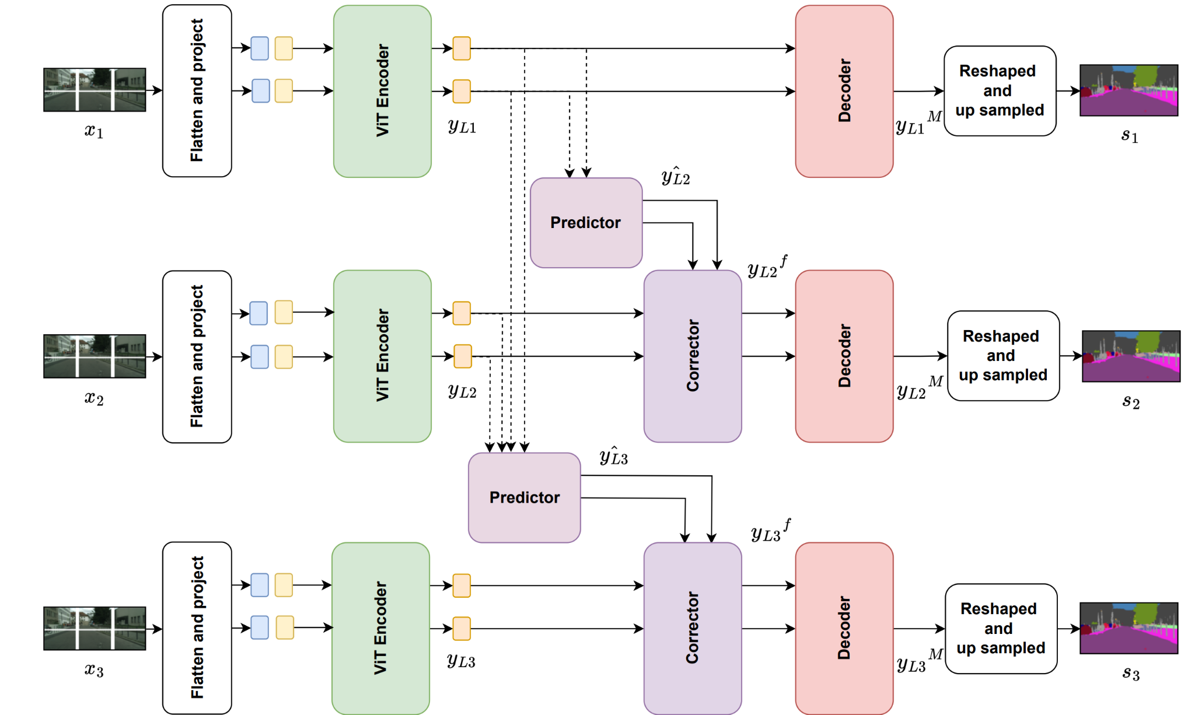
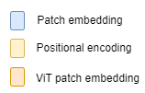
VideoSegmenter - Model overview

Slide 10
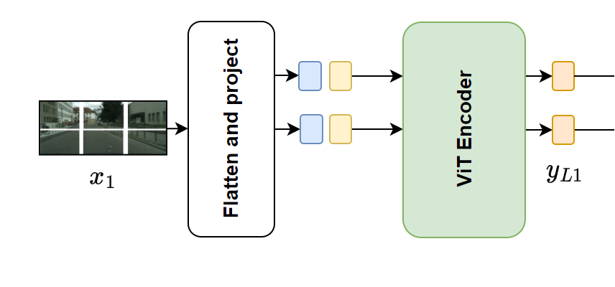
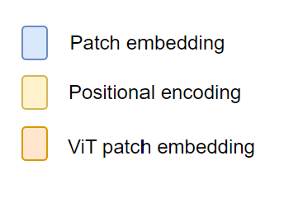
VideoSegmenter - ViT Encoder
Patches of fixed size.
Patch embeddings
Learnable positional encodings
ViT encoder : Transformer Block
Notes:
Each frame divided into patches of fixed size.
Each patch is flattened to a 1D vector and linearly projected to get patch embeddings.
In order to retain positional information, learnable positional encodings are added to the sequence of patch embeddings.
The ViT encoder is a transformer block consisting of L layers with multi-head attention and MLP blocks.

Slide 11
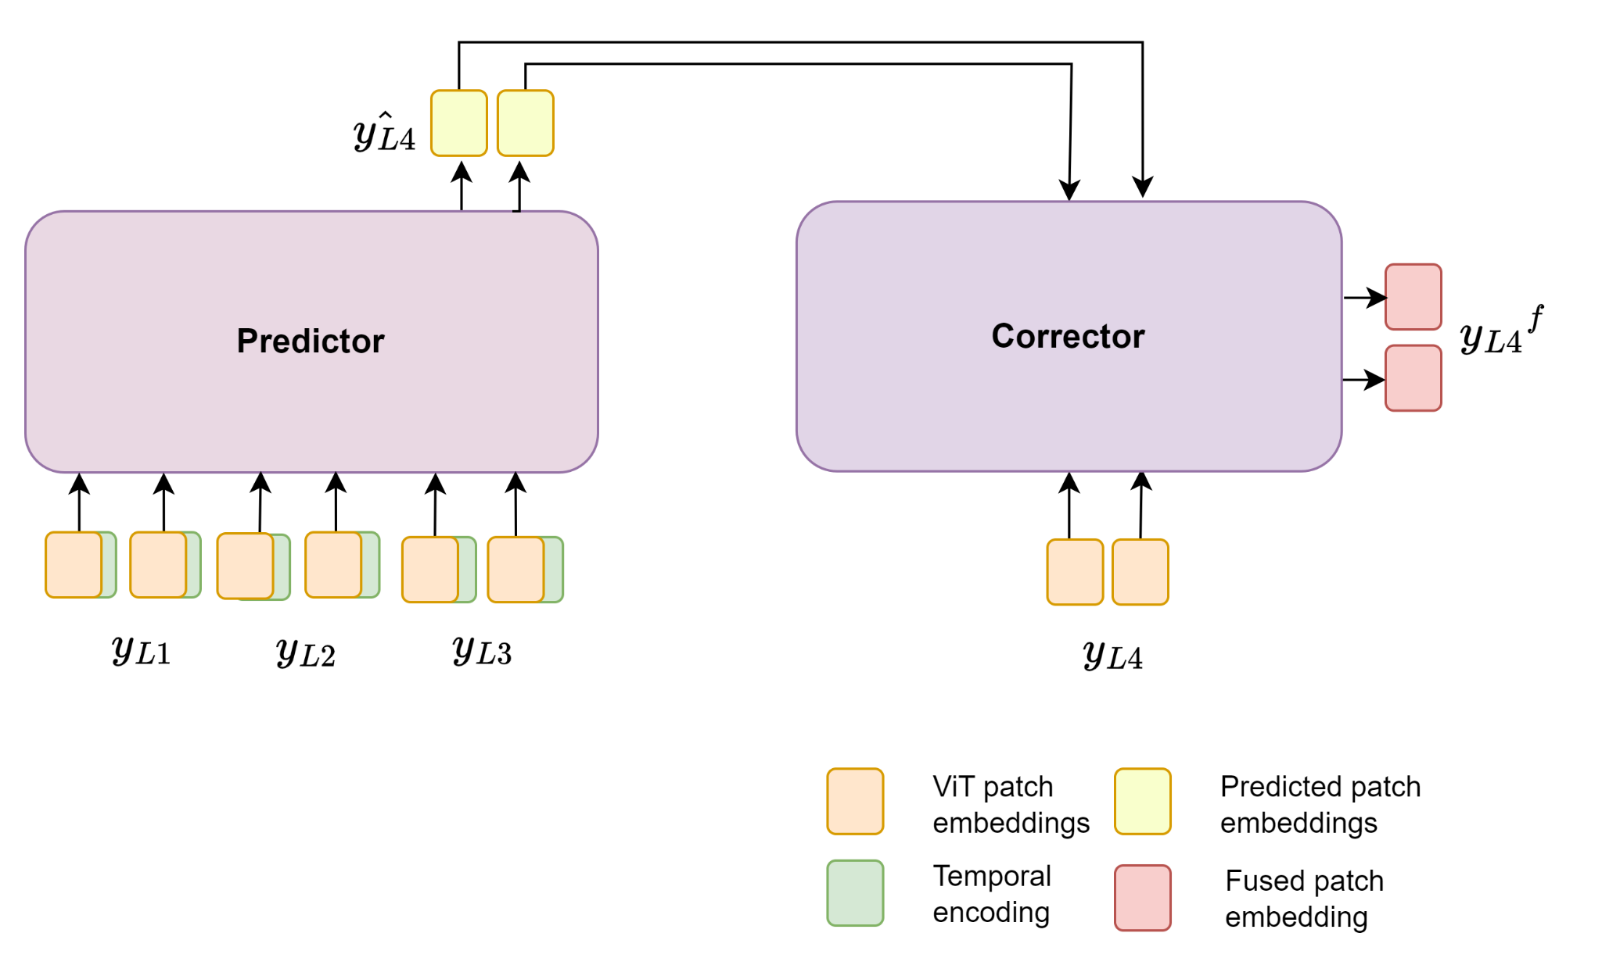
VideoSegmenter - Predictor-Corrector
Predictor
Predicts the patch embedding of the current frame.
Corrector
Fuses the predicted patch embeddings with ViT patch embeddings.

Slide 12
VideoSegmenter - Linear Decoder
Linear layer produces patch-level class logits.
Reshaped into 2-D feature maps.
Bilinearly upsampled to the original image size.
Softmax to get final segmentation maps.

Slide 13
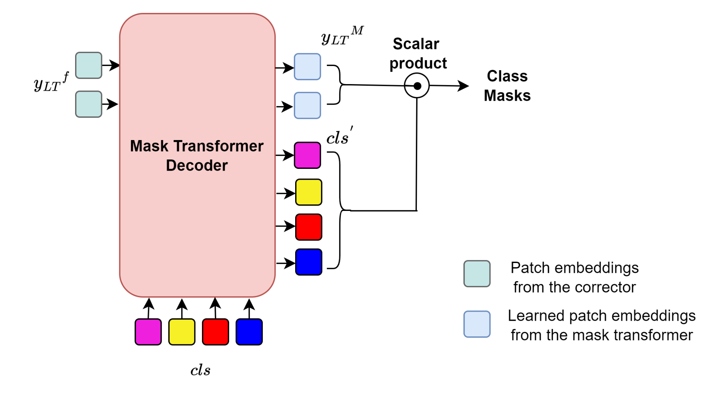
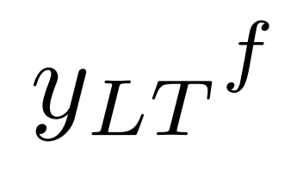


VideoSegmenter- Mask Transformer Decoder
Embeddings from Corrector module :
Learned class embeddings :
Mask Transformer Decoder :
Transformer Block
Two Layers

Slide 14
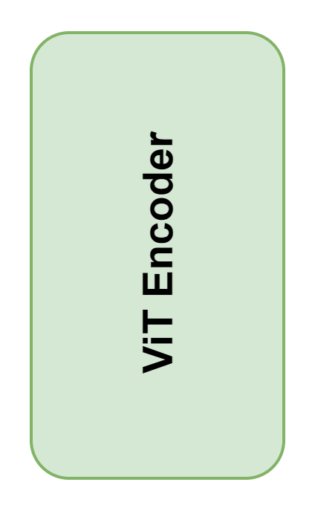

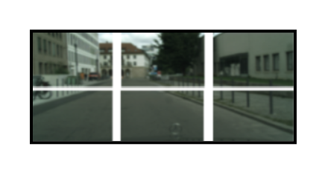



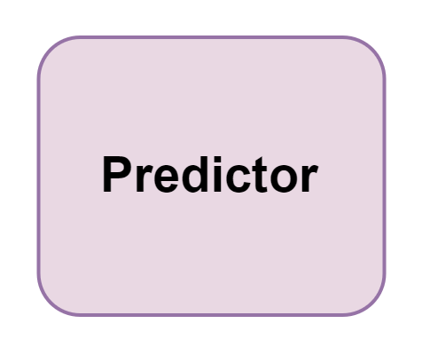
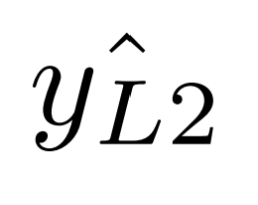

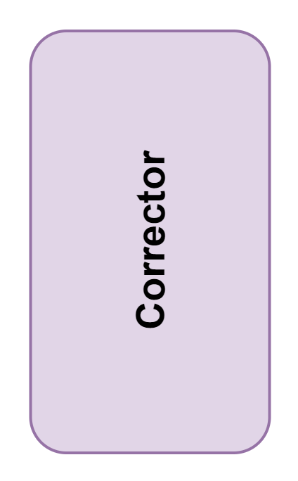
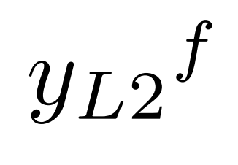
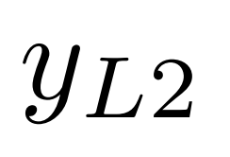
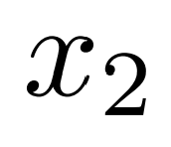

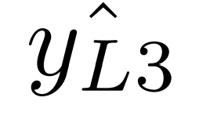
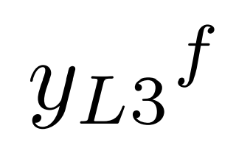



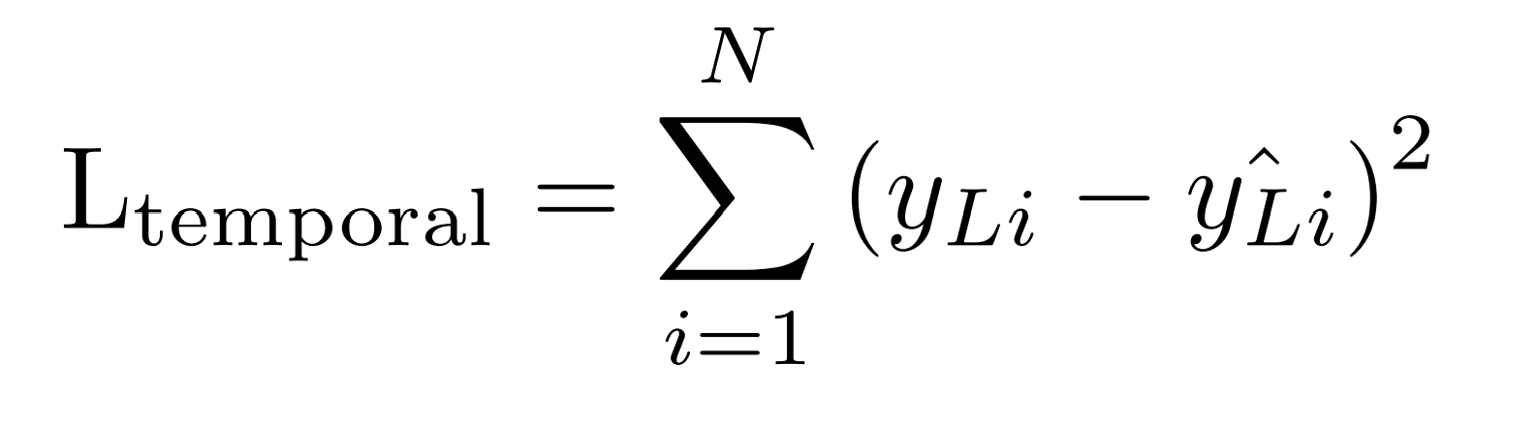
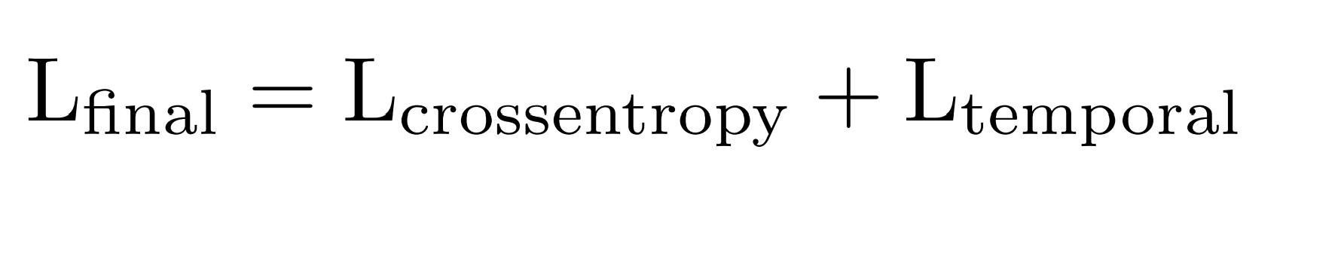
VideoSegmenter Training

Slide 15
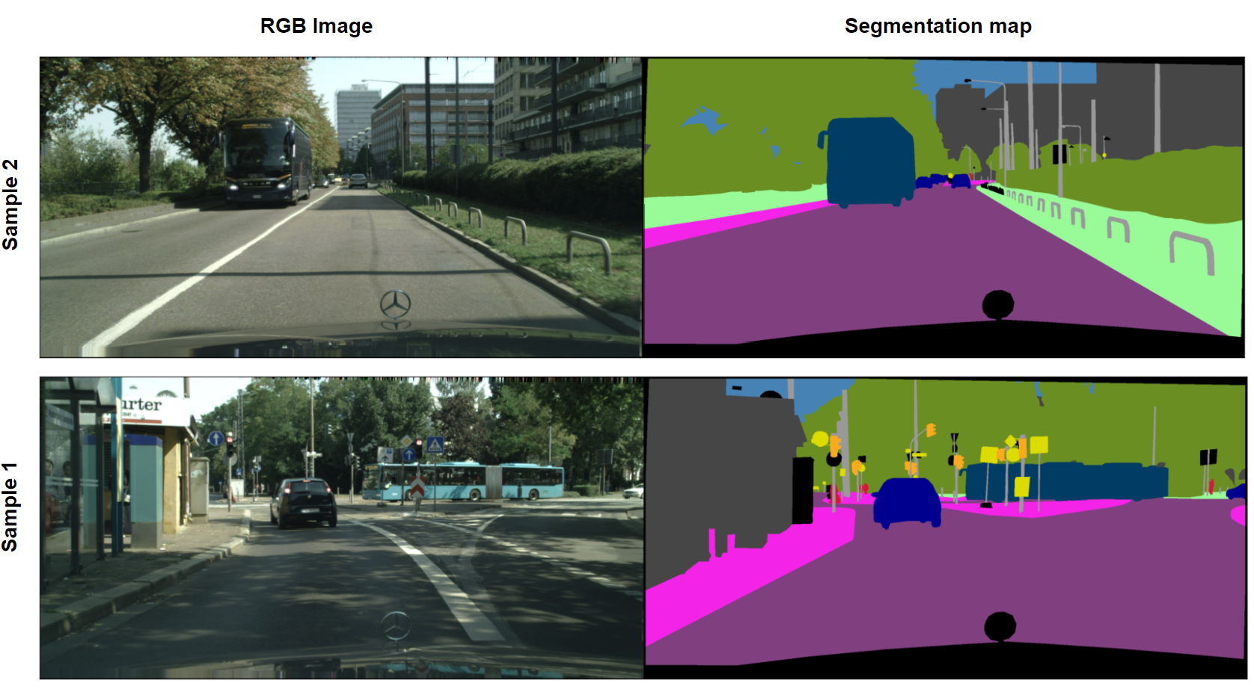
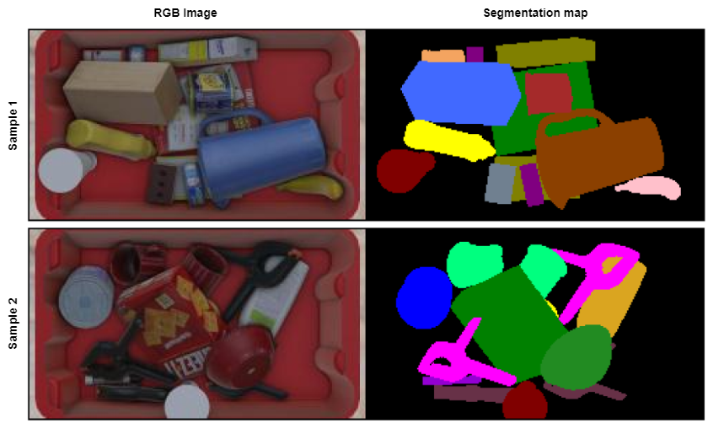
Evaluation - Datasets
Cityscapes
Synpick

Slide 16
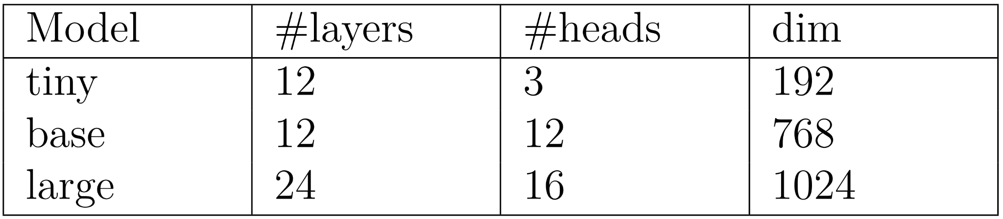
Evaluation - Variants of ViT encoder
Variants
Tiny
Base
Large
Table 1: Variants of the ViT encoder

Slide 17
Evaluation Results
Dataset - Synpick

Slide 18
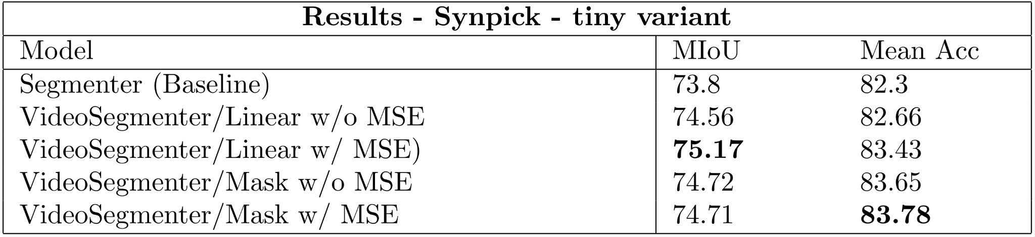
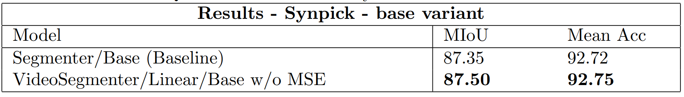
Results - Synpick
Table 2: Overview - Quantitative results, tiny variant
Table 3: Overview - Quantitative results, base variant

Slide 19


Synpick - Comparison with Baseline
Ground truth
Segmenter
VideoSegmenter
Segmenter
VideoSegmenter

Slide 20





Synpick - Comparison with Baseline
Ground truth
Segmenter
VideoSegmenter
Example 1
Example 2
More stable predictions

Slide 21






Synpick - Effect of patch size
Ground truth
VideoSegmenter/Linear/tiny/16x16
VideoSegmenter/Linear/base/8x8
Example 1
Example 2
Smaller patch size :
Defined boundaries for objects
Less object loss

Slide 22
Evaluation results
Dataset - Cityscapes

Slide 23
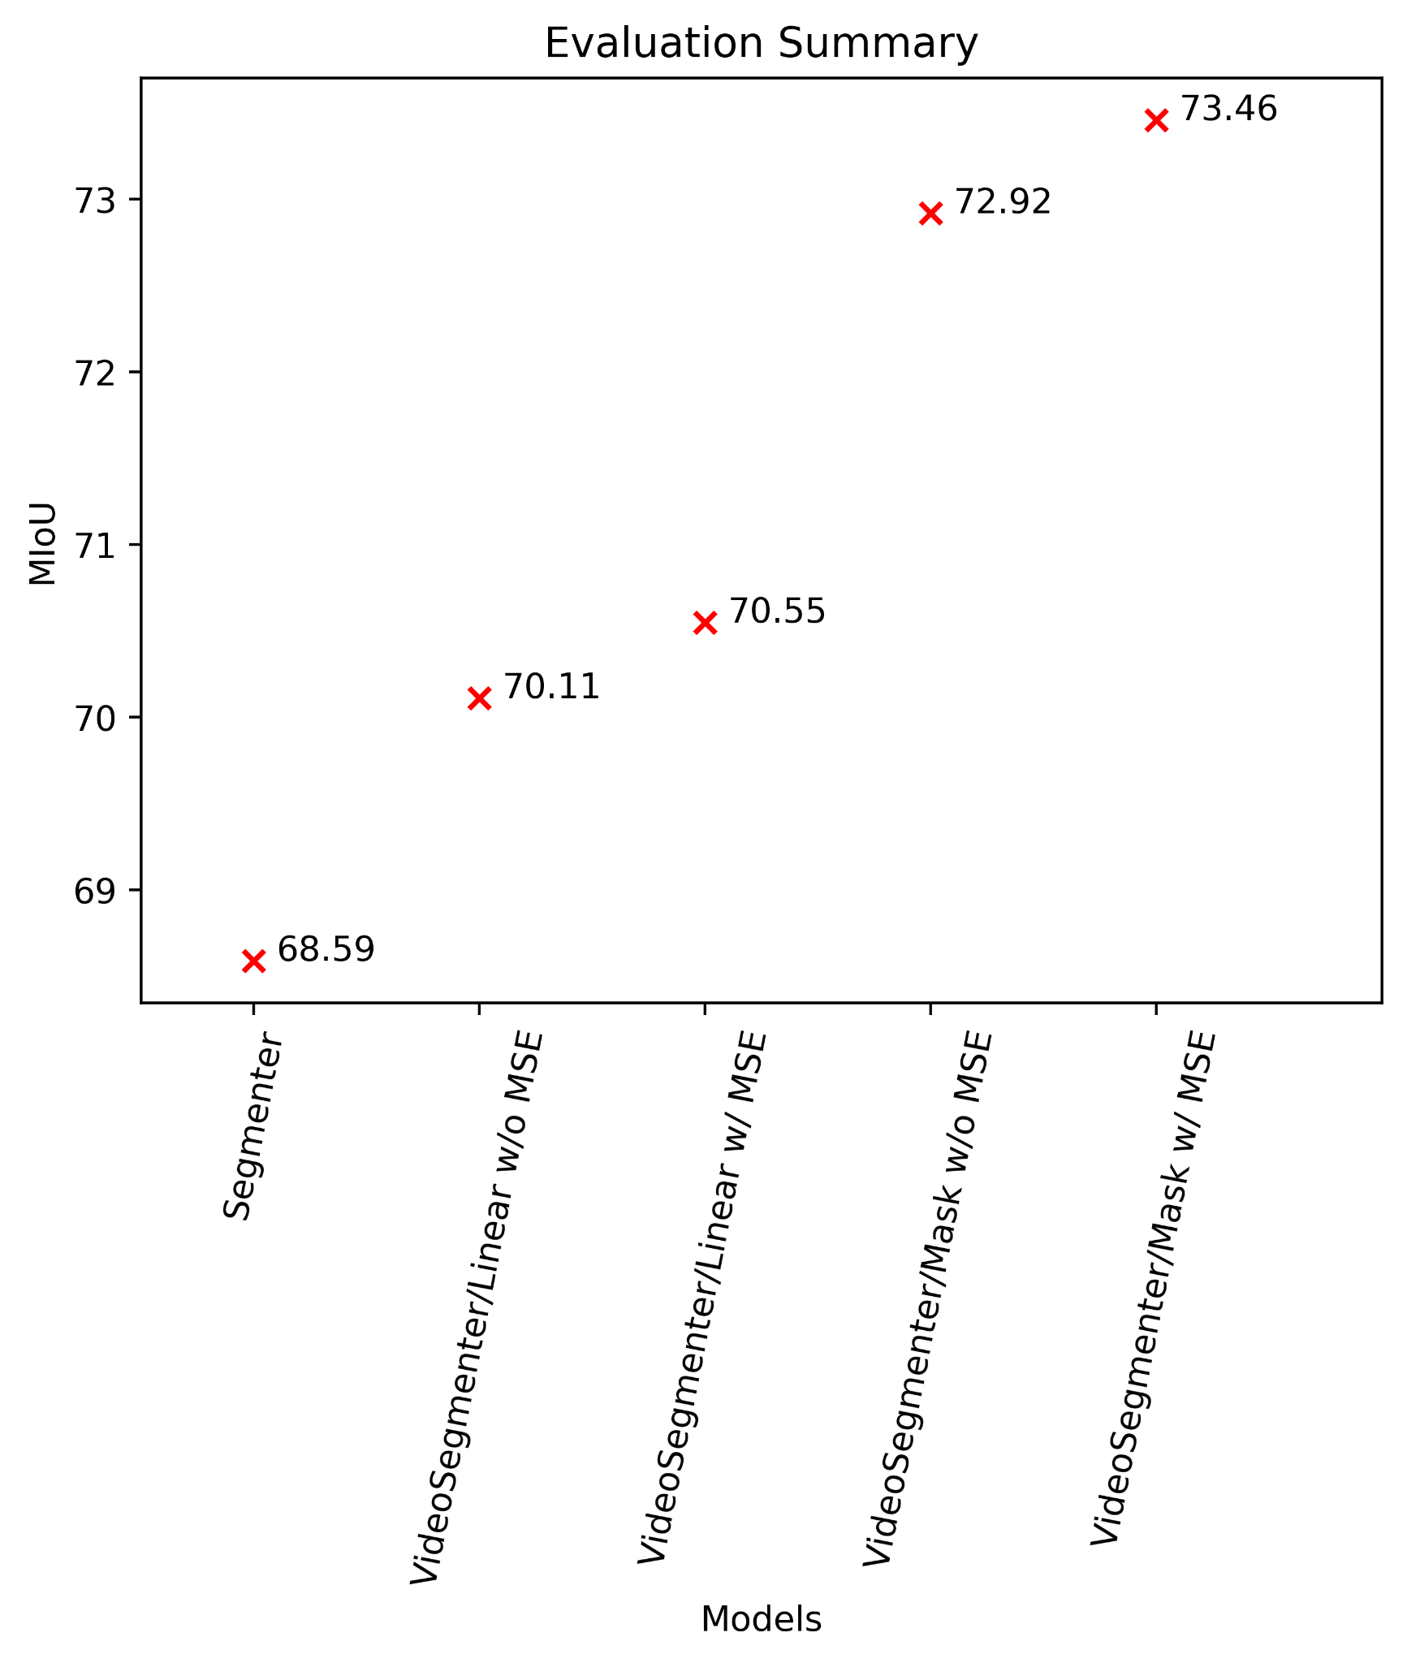
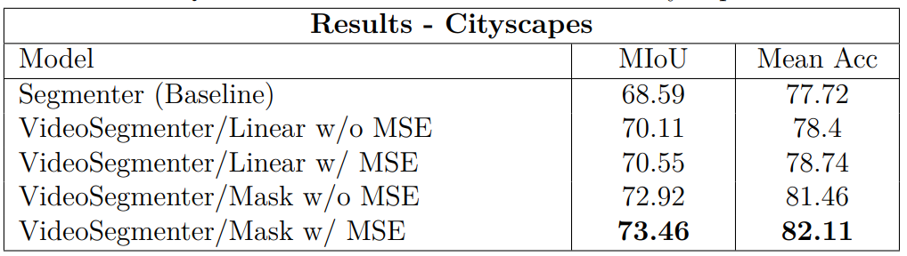
Results Cityscapes
Table 4: Overview - Quantitative results
Best model : VideoSegmenter/Mask w/ MSE
Significant rise of around 4%
Temporal regularization (MSE) improves performance

Slide 24


Cityscapes - Comparison with Baseline
Segmenter
VideoSegmenter
Temporally consistent segmentations.
Less noisy.
Segmenter
VideoSegmenter

Slide 25


Results - Cityscapes - Decoder comparison
Linear decoder vs transformer decoder
VideoSegmenter/Linear/MSE
VideoSegmenter/MaskTransformer/MSE
Mask Transformer
Better terrain prediction across frames
Linear decoder : struggles to differentiate between vegetation, terrain and sidewalk

Slide 26
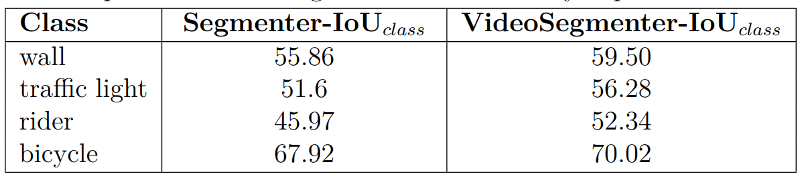
Results - Cityscapes - per class improvement
Table 5: Improvements per class
Significant improvements per class
Rider, Bicycle predicted better
Moving objects are predicted better
Adopting temporal relations helps

Slide 27
Conclusion

Slide 28
Conclusion and Final Remarks
Introduced the VideoSegmenter model:
Video extension of Segmenter
Integrates a prediction-correction approach for video segmentation
Temporal regularization.
VideoSegmenter model generates temporally consistent results.
Reducing patch size generates more defined boundaries segmented objects.
Outperforms the strong Segmenter baseline.

Slide 29
Future Scope
Use a stronger ViT variant for the encoder, eg: base, large variant.
Combine a stronger encoder with smaller patch sizes.
Further comparisons with more baseline models
Add further structure into model:
Ego - and camera motion prediction

Slide 30
References
Dosovitskiy, Alexey, et al. "An image is worth 16x16 words: Transformers for image recognition at scale." ICLR 2021.
Strudel, Robin, et al. "Segmenter: Transformer for semantic segmentation." CVPR 2021.
Pfeuffer, Schulz, et al. “Semantic segmentation of video sequences with convolutional lstms.” In: 2019 ieee intelligent vehicles symposium (iv). IEEE. 2019, pp. 1441–1447.
Cordts, Marius, et al. "The cityscapes dataset for semantic urban scene understanding." IEEE/CVF Conference on Computer Vision and Pattern Recognition (CVPR). 2016.
Periyasamy , Schwarz, et al. “SynPick: A Dataset for Dynamic Bin Picking Scene Understanding”. IEEE 17th International Conference on Automation Science and Engineering (CASE). 2021.
Vaswani, Ashish, et al. "Attention is all you need." NeurIPS 2017
Touvron, Cord, et al. “Training data-efficient image transformers & distillation through attention“. International Conference on Machine Learning, PMLR. 2021
Pradeep, Vishnu, et al. "Self-Supervised Sidewalk Perception Using Fast Video Semantic Segmentation for Robotic Wheelchairs in Smart Mobility" Sensors 22, no. 14: 5241. 2022

Slide 31
Thank You for your attention
Ready for questions!

